Slide 1
Samsung
Innovation
Campus
Artificial Intelligence Course

Slide 2

Food Mart (CFM)
Supervised By
Dr. Doaa Mahmoud
Eng. Mohammed Abdullah

Slide 3




About Us
1
4
Abdelmoneim Moustafa
Amr Elsaeed
2
3
Huzayfah‏ Nasef
Rania Hossam
3

Slide 4

Agenda
Problem Definition
Data Description
EDA (Exploratory Data Analysis)
Conclusion
and Recommendation
Business Solution
Feature Engineering
Data Modeling
Data Pre-Processing

Slide 5
Problem Definition
What’s FOODMART
Food Mart (CFM) is a chain of convenience stores in the United States. The private company's headquarters are in Mentor, Ohio, and there are currently approximately 325 stores located in the US.
Food Mart was the nation's third-largest chain of convenience stores as of 1988.
The NASDAQ exchange dropped Convenient Food Mart the same year when the company failed to meet financial reporting requirements.
1
2
3
Samsung Innovation Campus
5

Slide 6
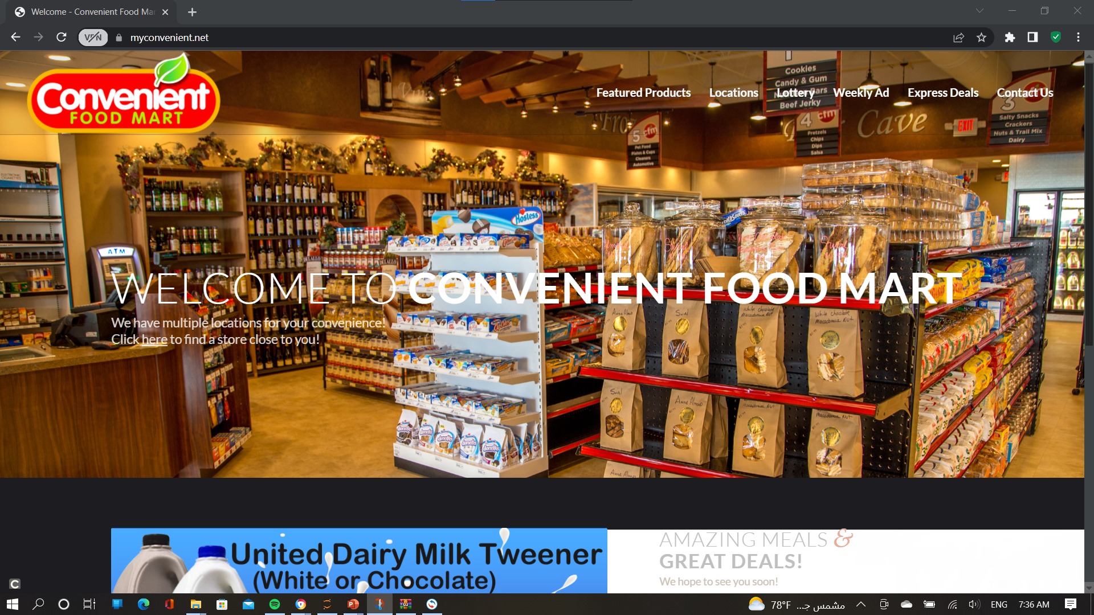
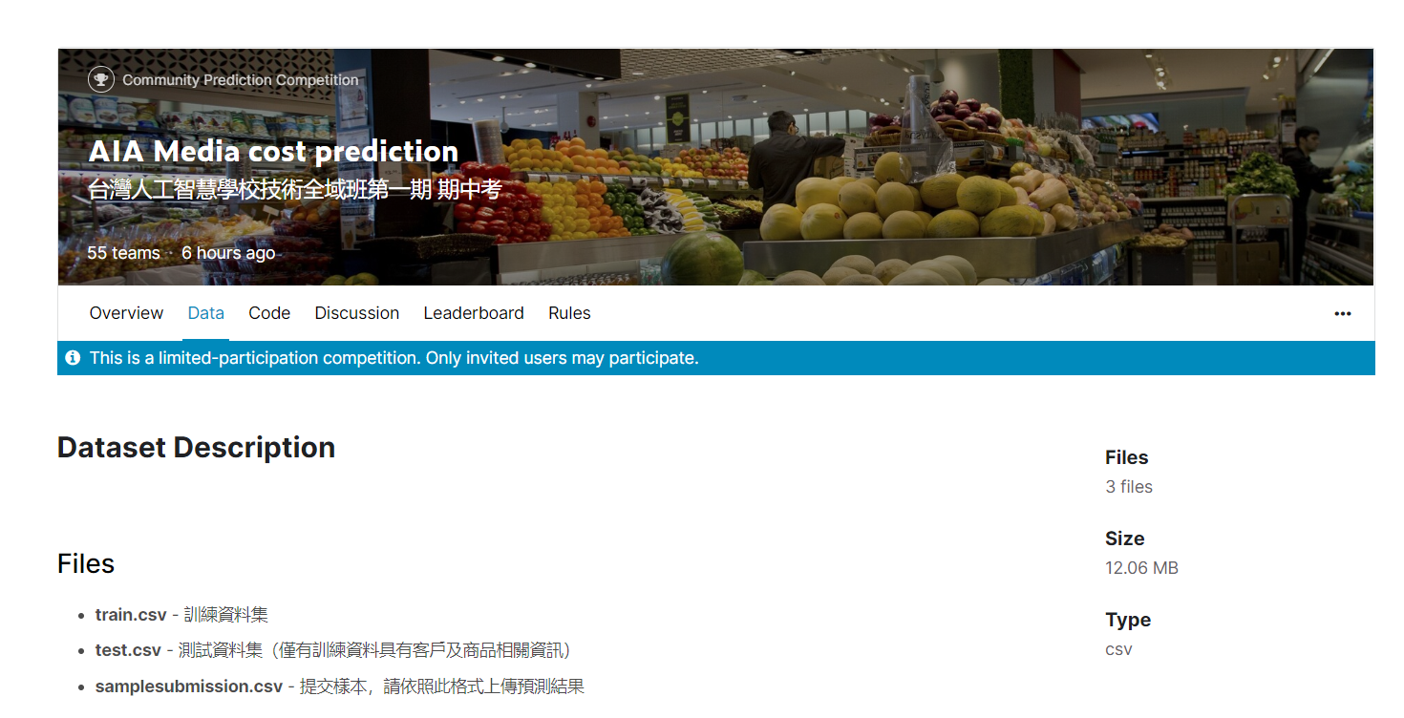
Problem Definition
Food Mart (CFM)
The purpose of data is to : PREDICT COST ON MEDIA CAMPAIGNS IN FOOD MART OF USA
6

Slide 7
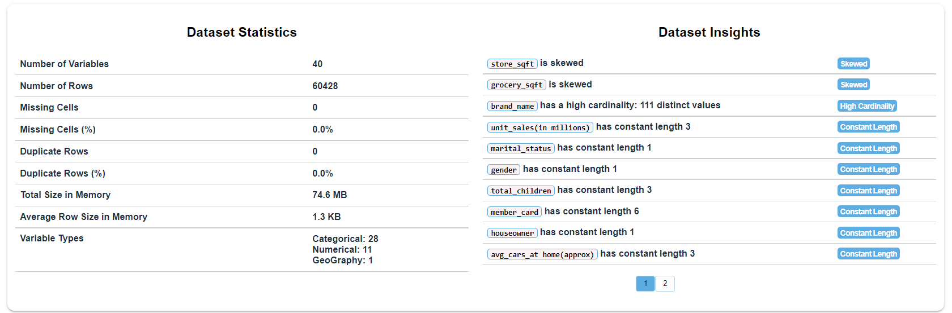
Data Description
Overview of data
Samsung Innovation Campus
7

Slide 8
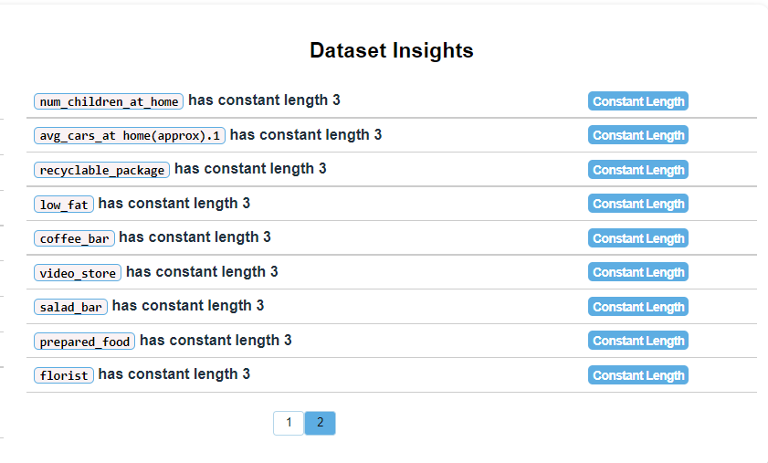
Data Description
Overview of data
Dataset is of 60k customers and 40 features.
No missing values.
No duplicate values.
We have a skewed feature
We have outliers and we are going to handle them later‏
8

Slide 9
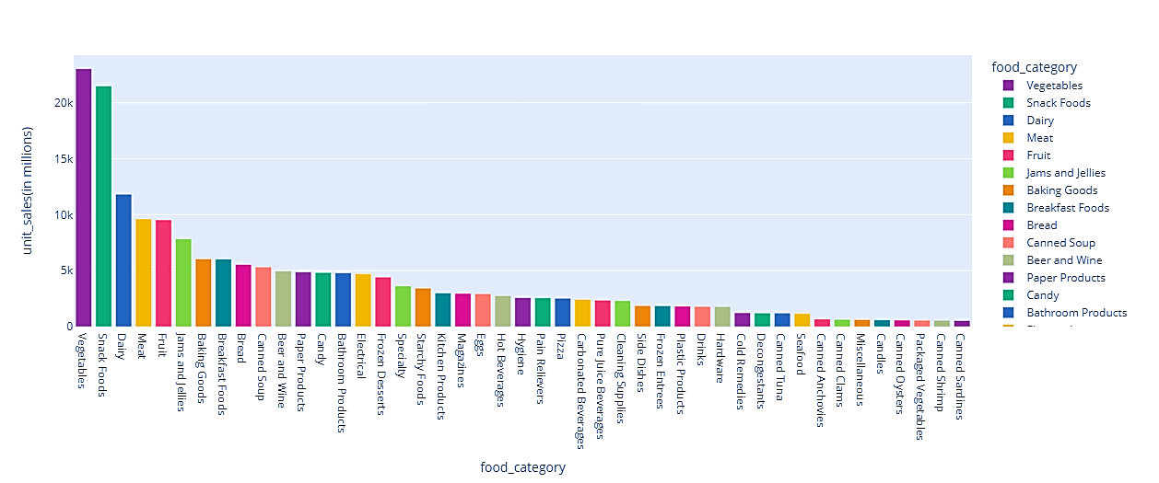
EDA
What are the three highest food categories achieving highest unit sales ?
Top three units sold of each type vegetables , snack foods and dairy.
Samsung Innovation Campus
9

Slide 10
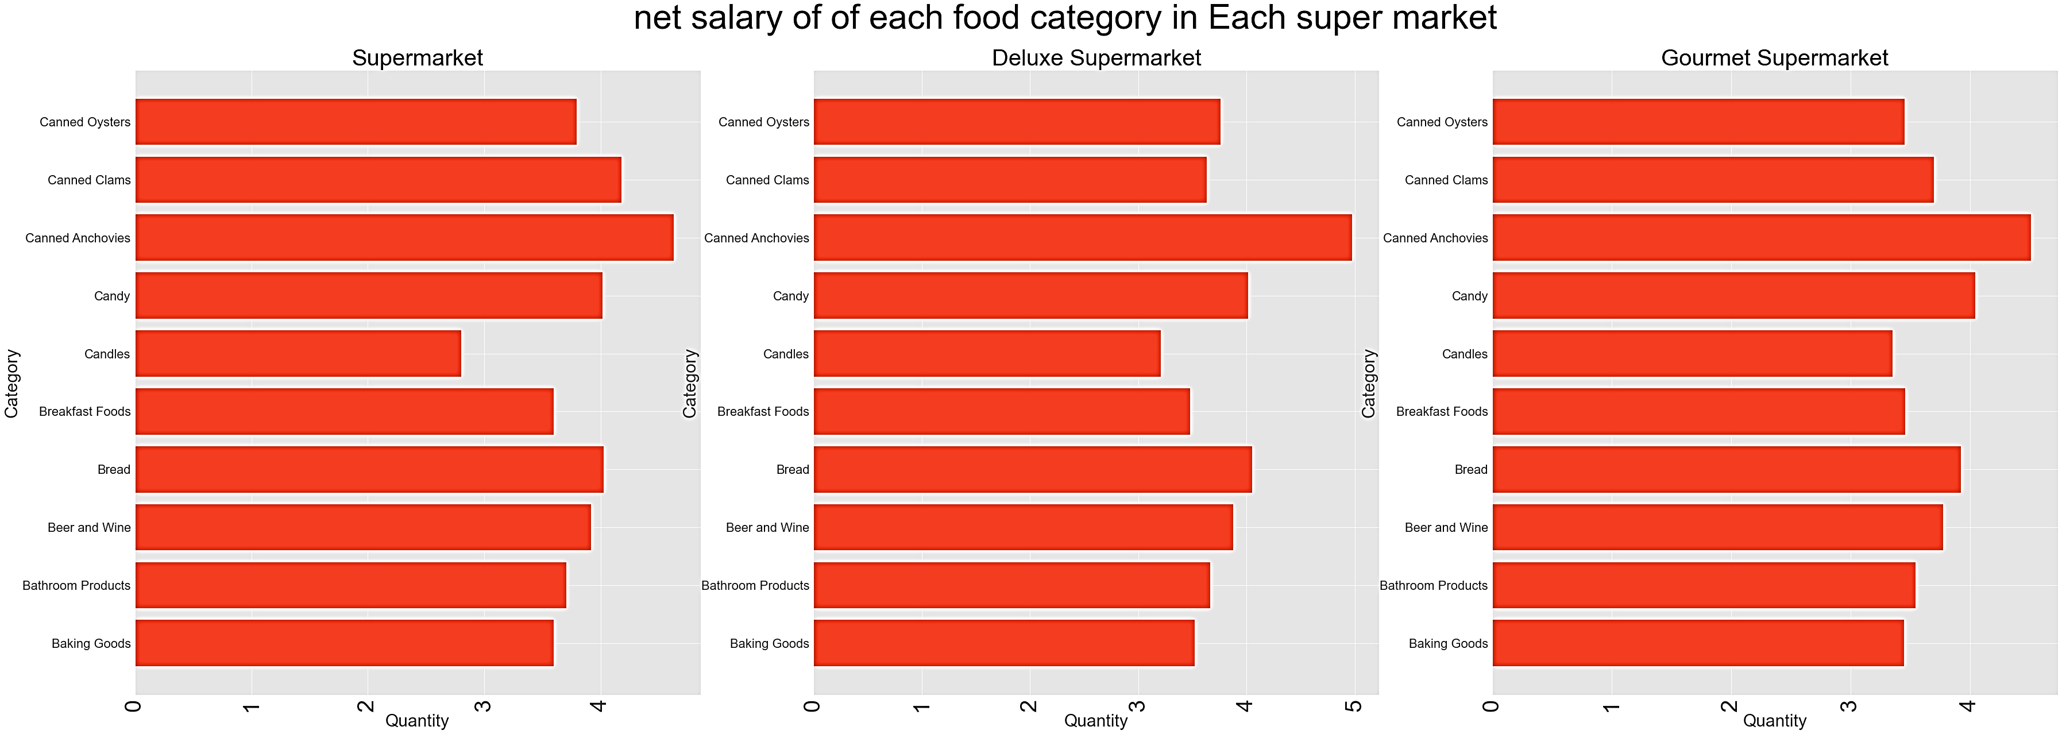
EDA
What are the three highest food categories in each highest supermarket?
In the three highest supermarket sales the highest food category is Canned Anchovies
Samsung Innovation Campus
10

Slide 11
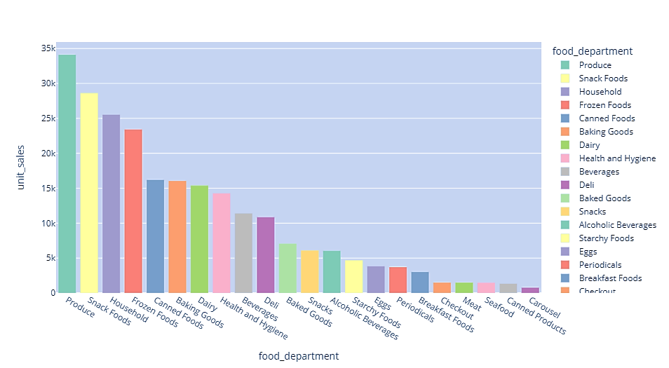
EDA
What is the best three food department according to net sales?
The best three department is produced, snake foods and household
11
Samsung Innovation Campus

Slide 12
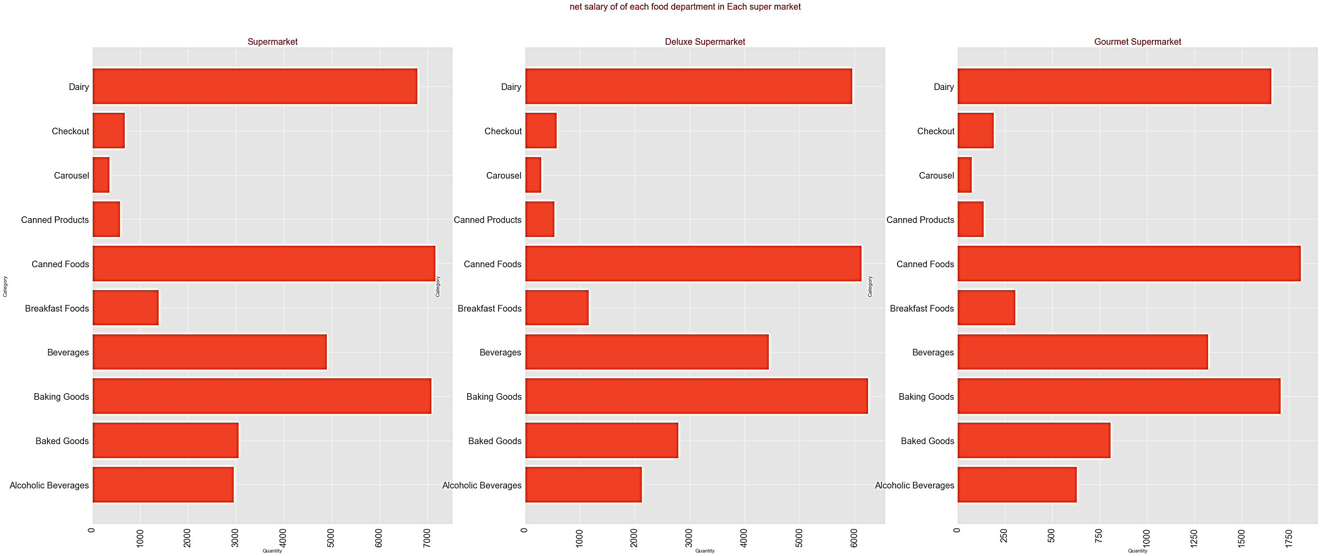
EDA
What is the best food department in each supermarket type ?
Dairy and canned food and baking good is the most three department in each supermarket
Carousel and checkout and canned products is the least three food department
Samsung Innovation Campus
12

Slide 13
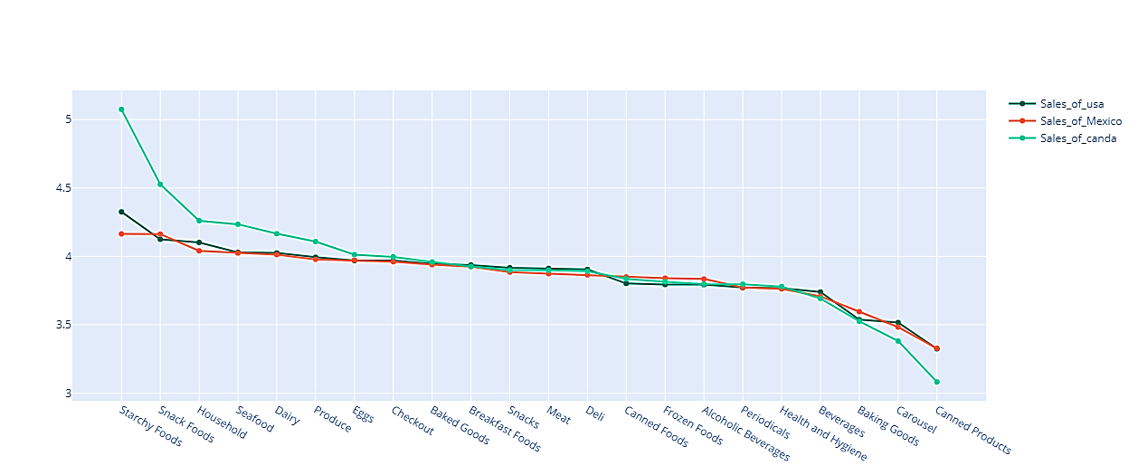
EDA
In each country which food department achieve highest net sales comparing to other countries?
CANADA has the highest net sales for starchy food and snack food department except from canned products department become to decrease
Samsung Innovation Campus
13

Slide 14
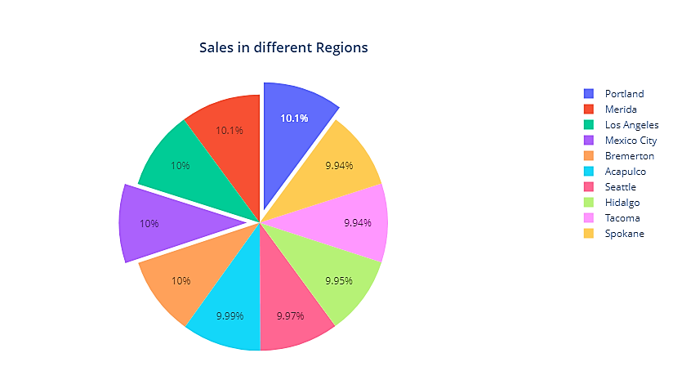
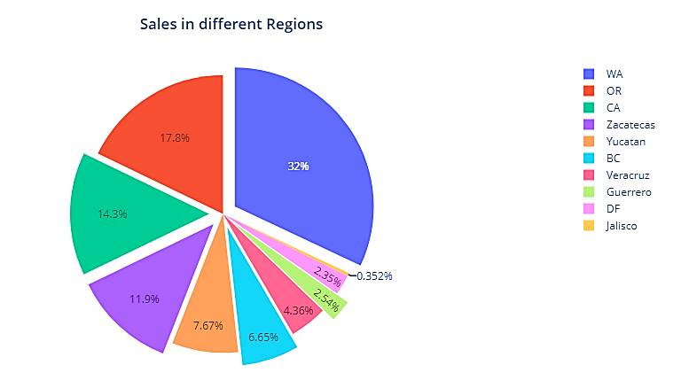
EDA
What is the highest city according to net sales?
Which states have better and worst net sales?
The highest two cities according to net sales is Portland and Merida
Washington , Oregon and California have the highest net salaries than the other state
Samsung Innovation Campus
14

Slide 15
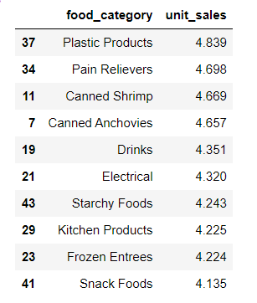
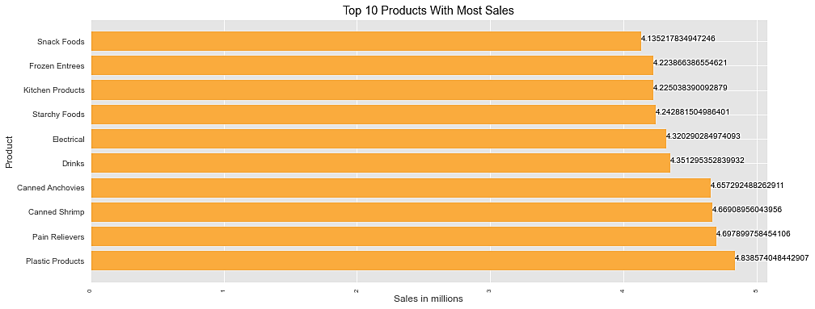
Business Question
What are the highest three food categories achieving the highest net sales?
we see that the (pain relievers and plastic products and canned shrimp) achieve the highest net sales
Samsung Innovation Campus
15

Slide 16
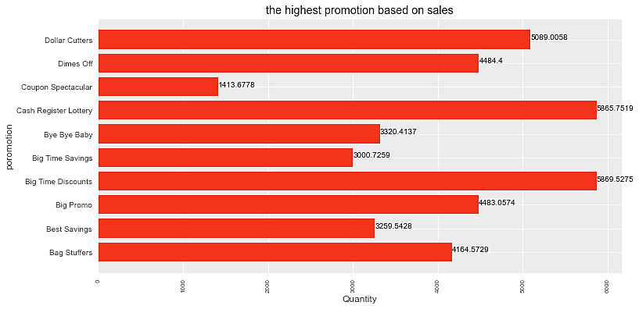
Business Question
What is the highest promotion based on net sales ?
The best 3 promotions is Big Time Discount , Cash register lottery and Dollar cutters.
Samsung Innovation Campus
16

Slide 17
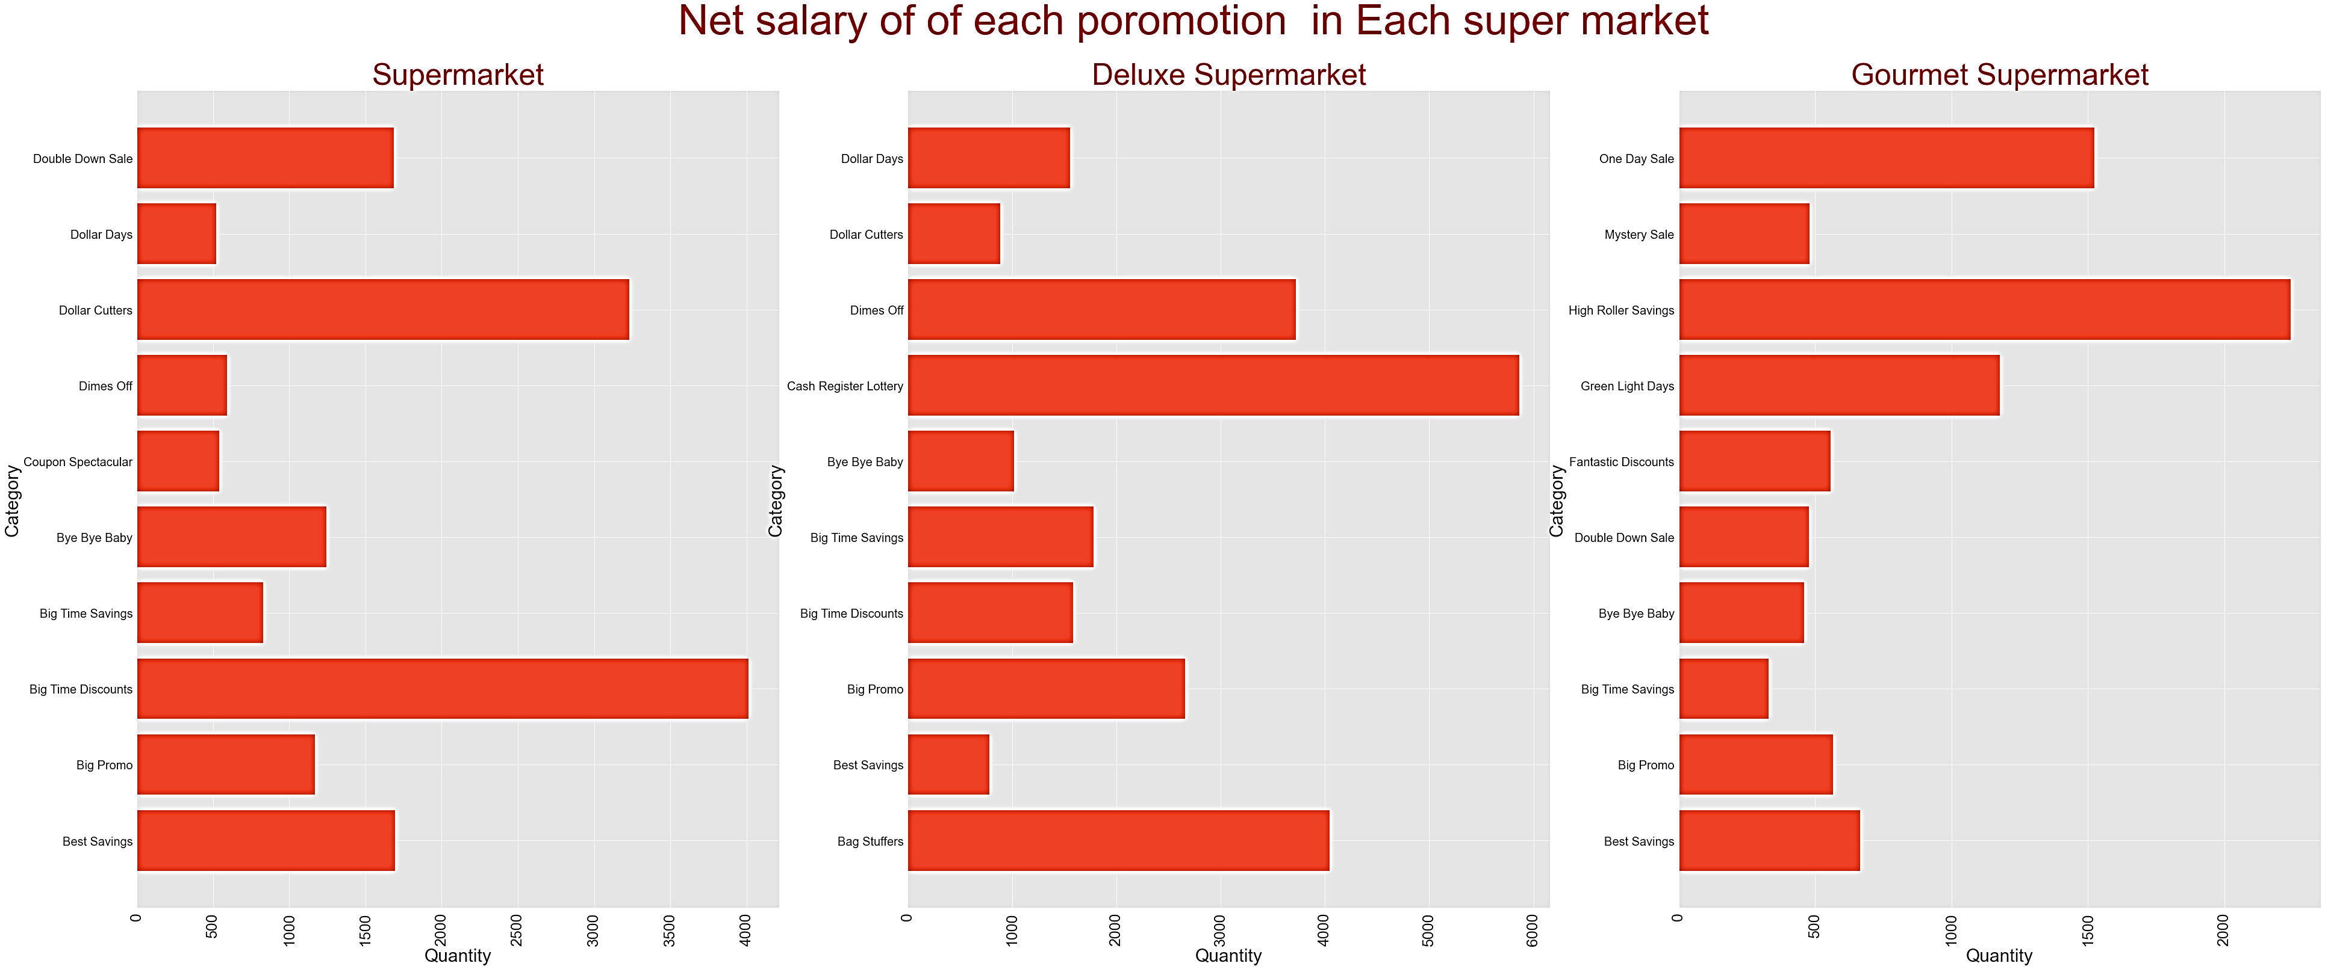
Business Question
Which promotion achieves the highest net sales in each supermarket ?
In supermarkets: the best two promotion are big time discounts and dollar cutters.
In deluxe supermarkets: the best two promotion are cash register lottery and bag stuffers.
In gourmet supermarkets: the best two promotion are high roller savings and one day sale
Samsung Innovation Campus
17

Slide 18
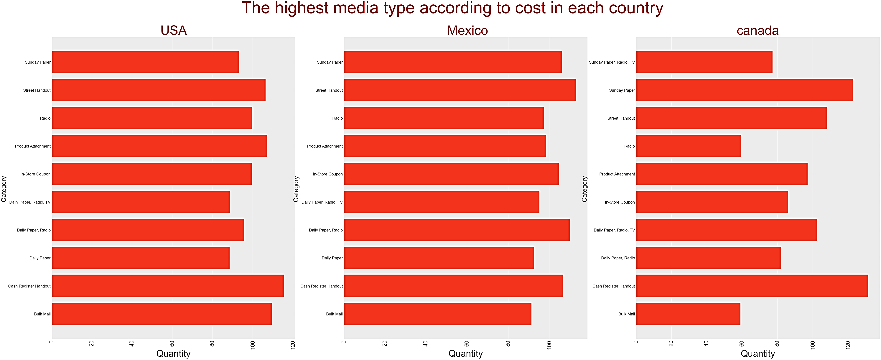
Business Question
Which media type achieves the highest cost in each country ?
in USA ,mexico and canada the highest cost is cash register
in usa , mexico the least cost is daily paper
in canada the least cost is radio
Samsung Innovation Campus
18

Slide 19
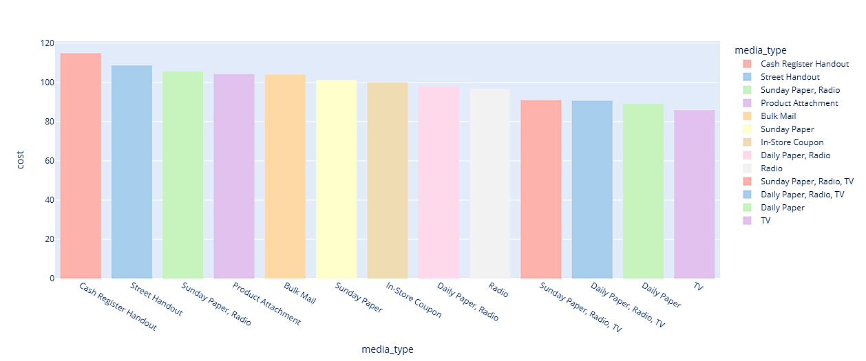
Business Solution
Which media type achieves the highest cost ?
cash register handout and street handout achieve the highest cost.
Samsung Innovation Campus
19

Slide 20
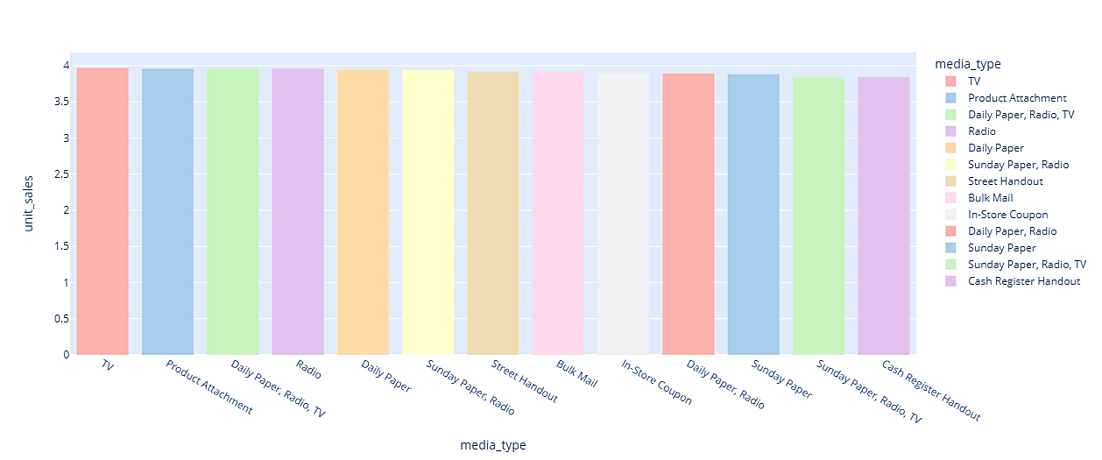
Business Solution
Which media type achieves the highest net sales ?
As we see from above that TV has the highest net sales for media type.
we recommend to use TV and daily paper and radio
Samsung Innovation Campus
20

Slide 21
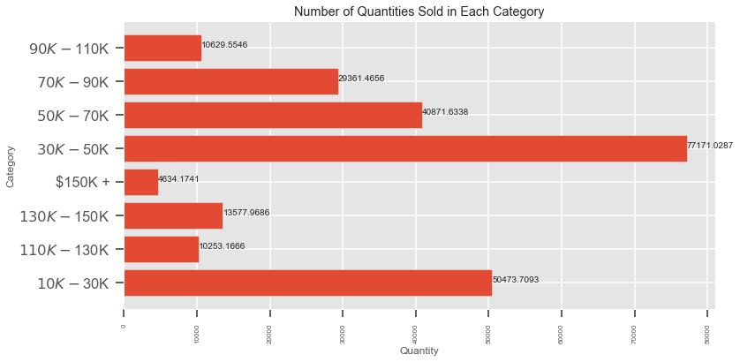
Business Solution
Avg yearly income with the most unit sales?
We found that the customer that take the average 30K : 50K achieve the highest net sales
We recommend for focus more from them.
21
Samsung Innovation Campus

Slide 22
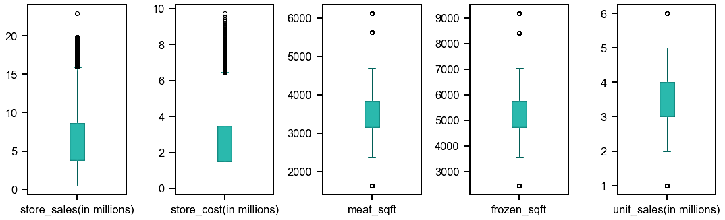
Data Pre-Processing
So, Let’s handle outliers
After processing the reason of outliers , We found that the best solution is to remove them
Samsung Innovation Campus
22

Slide 23
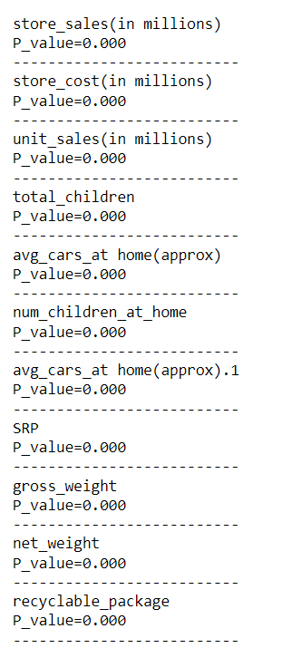
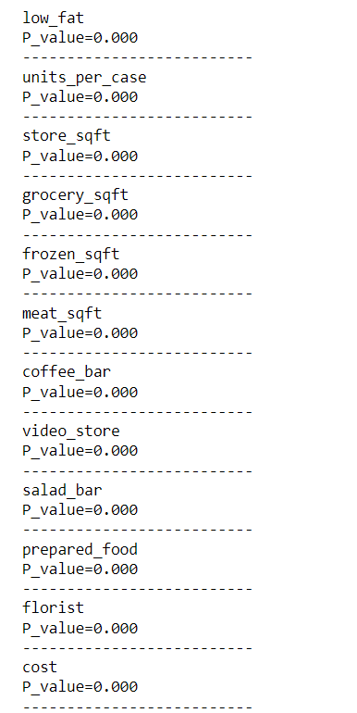
Feature Engineering
Shapiro-Wilk Normality Testㅤ
In Shapiro-Wilk Normality Test : H0 : The data are normally distributed
The numerical fields do not follow the normal distribution.
We solve it by using log function
Samsung Innovation Campus
23

Slide 24
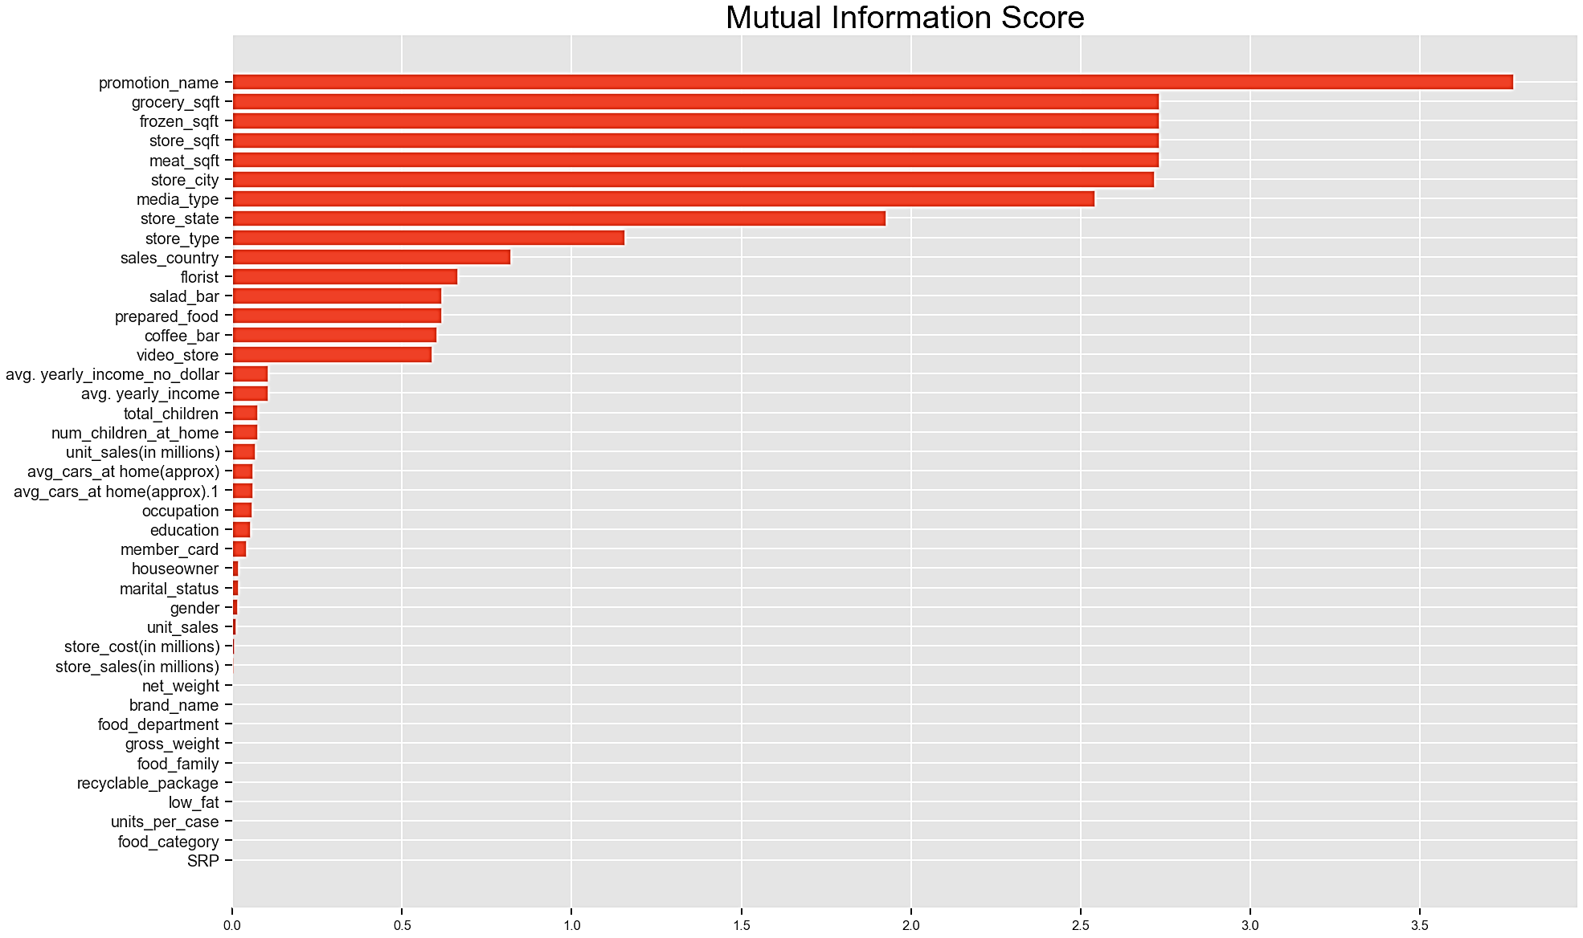
Feature Engineering
Mutual
Information Score
Samsung Innovation Campus
24

Slide 25
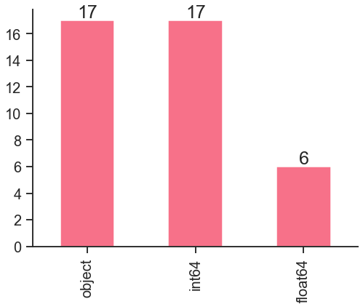
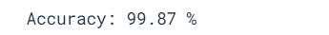
Data Modeling
As we see that we have many categorical variables so the optimal solution to use the ensemble model
Decision Tree Regression
Random Forest Regression
Light GBM Regression
The best model is : Random Forest Regression
We use cross validation with ten folds :
Samsung Innovation Campus
25

Slide 26
Data Modeling
Compare between models
Model | Decision Tree Regression | Random Forest Regression | Light GBM Regression
MAE | 0.033 | 0.052 | 3.17
MSE | 1.25 | 0.61 | 20.38
RMSE | 0.18 | 0.22 | 1.78
R2 Score | 0.998 | 0.999 | 0.977
Samsung Innovation Campus
26

Slide 27

Our Recommendation
The best media type we recommend is TV.
The best food category we recommend is plastic products and pain relievers ,canned shrimp.
The best food category we recommend are canned food especially seafood like anchovies and shrimp.
The best promotion will be recommended for increasing net sales are big time discount , cash register lottery and dollar cutters.
The best promotion for every country after analysis is cash register
The best media type that affect the cost of acquiring a new customer is tv and daily paper and not recommended not using any media relating to hand out by it affect the cost and not achieving high sales
Samsung Innovation Campus
27

Slide 28
THANKS!
Do you have any questions?
Data Link :
https://www.kaggle.com/datasets/ramjasmaurya/medias-cost-prediction-in-foodmart
Samsung Innovation Campus
28

